Slide 1


Spreadsheet Project : Zomato Restaurant Analysis
Submitted by :
Shahbaaz Shaikh

Slide 2
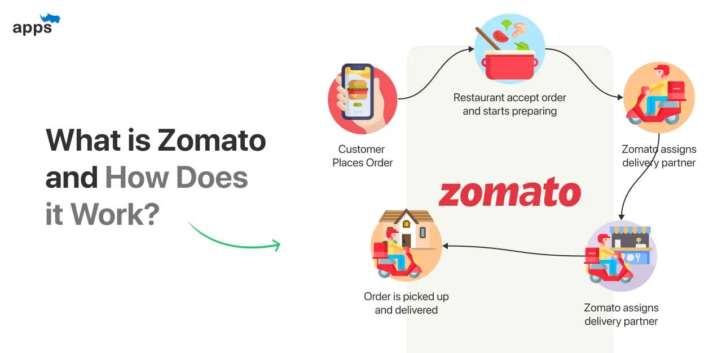
ABOUT ZOMATO
Zomato is a popular multinational restaurant aggregator and food delivery company that has expanded its services globally. Zomato provides information, menus and user-reviews of restaurants as well as food delivery options from partner restaurants.

Slide 3
AGENDA
Problem Statement
Data Description
Insights and Visualization
Strategic Recommendation
Dashboard

Slide 4
Problem Statement
You are hired as a consultant data analyst by Zomato where the team is looking for expansion and opening restaurants. Your task is to come up with strategies/suggestions about opening newer restaurants.

Slide 5
DATA DESCRIPTION
The dataset contains information about 9,551 restaurants with 20 columns detailing various attributes of these establishments. Below is an overview of the dataset:
Restaurant ID: Unique identifier for each restaurant.
Restaurant Name: The name of the restaurant.
Country Code: Country code of the location where the restaurant is situated.
City: The city where the restaurant is located.
Address: The specific address of the restaurant.
Locality: The locality or neighborhood where the restaurant is situated.
Locality Verbose: Detailed information about the locality.
Longitude: The geographical longitude coordinate of the restaurant.
Latitude: The geographical latitude coordinate of the restaurant.
Cuisines: The type of cuisine offered by the restaurant.
Currency: The currency used for transactions in the restaurant.
Has_Table_booking: Indicates whether the restaurant has a table booking option (Yes/No).
Has_Online_delivery: Indicates whether the restaurant offers online delivery (Yes/No).
Is_delivering_now: Indicates whether the restaurant is currently delivering (Yes/No).
Switch_to_order_menu: Indicates whether users can switch to the order menu (Yes/No).
Price_range: A numeric value indicating the price range category of the restaurant.
Votes: The number of votes or ratings/(feedback) received by the restaurant.
Average_Cost_for_two: The average cost for two people dining at the restaurant.
Rating: The overall rating of the restaurant is based on user reviews.
Datekey_opening: The date when the restaurant was opened.

Slide 6
Data Cleaning:
Removed the rows with missing Cuisines.
Trimmed the extra spaces in Address, Locality, locality Verbose
Made ORDER ID consistent , ensure all order id is of 8 characters
Removed the rows having Average price for two = 0.
Pre-processing:
Identified the state name from the cities name by using ChatGPT, and added it as a row
Added the country for respective country code using V-lookup Function
Changed all the ‘average price for two’ currency into INR and then categorized them under Range in new column ‘Average_Cost_in_INR’
Extracted the opening year, month from ‘Date key opening’ using TEXT function
Total restaurants | 9528
Total Country | 150
Total Cities | 140
Total Cuisines | 1821
Service offered | Table booking , Online Delivery
Average Rating | 2.9
Average Price in INR | Rs. 811

Slide 7
SUGGESTIONS FOR THE COUNTRY
To determine the lesser competition, I used following parameters to visualize through pivot table and make recommendations for country to open new restaurants
A. Density of restaurants:
Geographical size of the country. (Canada being the largest)
Count of restaurants in Country
Count of states and Cities in the Country
B. Average Rating & Average Number of Votes

Slide 8
Insights and Visualization
1. Geographical Size of the Country
Rank | Country
1 | Canada
2 | United States of America
3 | Brazil
4 | Australia
5 | India
6 | Indonesia
7 | South Africa
8 | Turkey
9 | Philippines
10 | New Zealand
11 | United Kingdom
12 | United Arab Emirates
13 | Sri Lanka
14 | Qatar
15 | Singapore

Slide 9
Count of restaurants in Country
Calculated the total number of restaurants per country and explored yearly trends, visualizing these insights through intuitive charts for better Strategic Decision Making.
It will be very advisable to open up the new restaurants. Like- Canada, Australia

Slide 10
Average Number of Votes
Evaluated operational aspects such as the average number of voters per restaurant by country, providing a comparative analysis of customer engagement.
Countries with high no. of voters depicts higher interaction with customers.

Slide 11
AVERAGE RATING OF RESTAURANTS IN EACH COUNTRY
Utilized statistical methods to calculate critical metrics such as average ratings for guiding operational improvements and strategic adjustments.
Country with high rating and low rating have their won reasons to be considered for opening new restaurants:
HIGH RATING- Such countries have high market appeal.
LOW RATING- Such countries have opportunity for improvement

Slide 12
SUGGESTED COUNTRIES - SCOPE OF IMPROVEMENT
Canada
Only 4 restaurants are opened in 4 different cities and 3 different states
Second lowest average rating of restaurants
Conclusion: Canada has a high number of restaurants but a comparatively low average rating, indicating potential issues with quality or customer satisfaction. Expansion efforts should prioritize enhancing restaurant standards rather than simply adding more locations.
India
The country with the highest number of restaurants has the lowest average restaurant rating compared to other countries.
Conclusion: - The country with the most restaurants also has the lowest average rating, highlighting possible quality or satisfaction issues. Expansion strategies should focus on raising restaurant standards instead of just increasing the number of outlets.
Total NO. OF Restaurants | 4
No. OF States | 3
No. OF Cities | 4
Average Rating | 3.6
Average Number of Votes | 103
Total NO. OF Restaurants | 8652
No. OF States | 28
No. OF Cities | 43
Average Rating | 2.8
Average Number of Votes | 137

Slide 13
SUGGESTED COUNTRIES - HIGH MARKET APPEAL
Australia
Less no. of restaurants and bigger in geographical size as compare to all other countries. Only 24 restaurants in 23 cities
A moderately average restaurant rating accompanied by impressive customer interactions.
Conclusion:
New restaurants can be opened due to the low number of existing establishments and high market appeal.
United Kingdom
80 Restaurants in 4 different cities but it has large geographical size. So it can accommodate few new restaurants.
One of the highest average rating of restaurants with biggest data of customer interactions
Conclusion:
New Restaurants can be opened because high market appeal and its large geographical size.
Total NO. OF Restaurants | 24
No. OF States | 6
No. OF Cities | 23
Average Rating | 3.7
Average Number of Votes | 111
Total NO. OF Restaurants | 80
No. OF States | 4
No. OF Cities | 4
Average Rating | 4.1
Average Number of Votes | 205

Slide 14
SUGGESTIONS FOR THE STATE AND CITY
I suggested states and the cities having less no. of restaurants holding high potential of expanding there.
Suggested Country | City 1 | City 2 | City 3
Canada | Edmonton | Toronto | Yorkton
Australia | Albany | Penola | Montville
United Kingdom | Leeds | Glasgow | Belfast
India | Faridabad | Mohali | Secunderabad

Slide 15
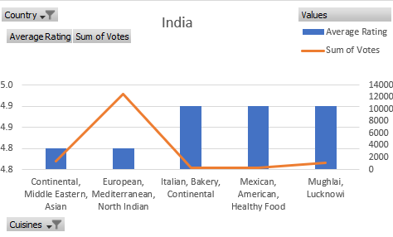
CUISINES TO FOCUS IN NEWER RESTAURANTS
To decide Which Cuisines, we should focus on in the newer Restaurant, We will focus on two factors: Cuisine’s rating & total votes each cuisines got.
Analysis
I Identifying key cuisines across countries for strategic expansion
In my research on potential markets for expansion , I mostly focused on identifying the top 5 cuisines in each country India, Australia, Canada, and the United Kingdom based on the highest average ratings.
India: My initial analysis revealed that in Faridabad, there isn’t a specific cuisine that stands out in popularity, and other cities have limited representation with only one or two restaurants each. Due to this sparse data, we chose to prioritize the top 5 cuisines across the country based on their average ratings, providing a clearer picture of what resonates best on a national level.

Slide 16
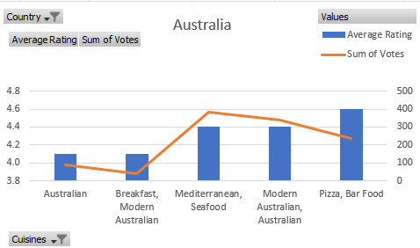
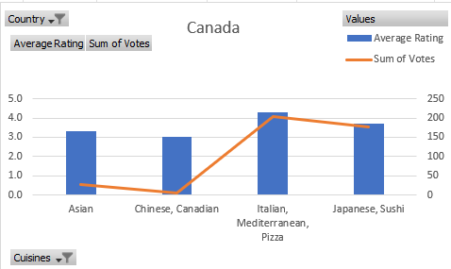
Australian Cuisine
Modern Australian Fusion: This cuisine emphasizes a blend of local, high-quality ingredients with international influences, creating innovative dishes that appeal to both locals and tourists.
Seafood & Grill Specialties: Given Australia's extensive coastline, fresh seafood dishes (like prawns, barramundi, and oysters) and premium beef from steakhouses are mainstays, with both being served in creative, modern ways.
Canadian Cuisine
Modern Canadian: This cuisine celebrates local heritage with dishes like poutine and bannock, emphasizing fresh, locally sourced ingredients that reflect Canada’s culinary identity.
Italian Classics: Italian classics like pasta and Neapolitan-style pizza are widely loved, with many venues offering authentic, high-quality Italian dishes.
Japanese Specialties and Sushi: Sushi and traditional Japanese dishes are highly popular, especially in cities like Vancouver and Toronto.

Slide 17
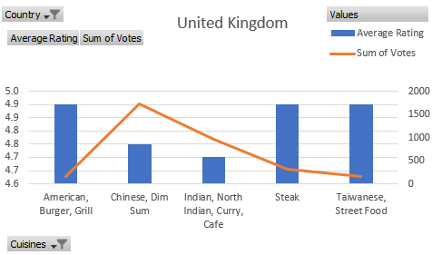
United Kingdom
Indian: Indian cuisine is widely beloved, with curry houses and fusion establishments rated among the highest.
British/Modern British: Traditional dishes like fish and chips, roast dinners, and modern interpretations of British classics are highly rated.
Italian: Italian cuisine, especially pasta, risotto, and artisan pizzas, is popular across the UK.
Chinese: High-quality Chinese restaurants, especially Cantonese and Sichuan cuisines, have consistently strong ratings.
Middle Eastern: Middle Eastern cuisine, including Lebanese and Turkish dishes, is well-regarded for flavorful and healthy options.
Conclusion:
This approach allows us to make data-driven decisions on which cuisines have the most growth potential in each country, guiding us toward informed and strategic restaurant expansions in each region.

Slide 18
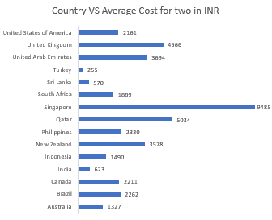
Expenditure Analysis
Observation :
Countries with average costs below 2,000 INR (e.g., India at 623 INR, Turkey at 255 INR) offer affordable dining options.
Moderate costs between 2,000 and 5,000 INR (e.g., Brazil, Philippines, Canada) indicate mid-range dining experiences.
Higher costs above 6,000 INR (e.g., Singapore at 9,485 INR, UK at 4,566 INR) suggest premium dining, highlighting regional differences in standards and culinary markets.
Conclusion :
Higher dining costs often align with premium experiences, suggesting that customers value the quality and exclusivity of higher-priced options, linking cost to customer satisfaction.

Slide 19
BOOKING OPTIONS AND DELIVERY OPTIONS
Pie charts were used to display categorical data distributions, such as booking options and delivery services, providing a clear overview of operational characteristics.
Highest Rating – 3.5
Service : Both table booking and Online Delivery
Lowest Rating – 2.8
Service : Neither table booking nor Online Delivery
CONCLUSION: Either of the Table Booking or Online Delivery service should be considered in newer restaurants. If feasible, Both services should be there for better Rating

Slide 20
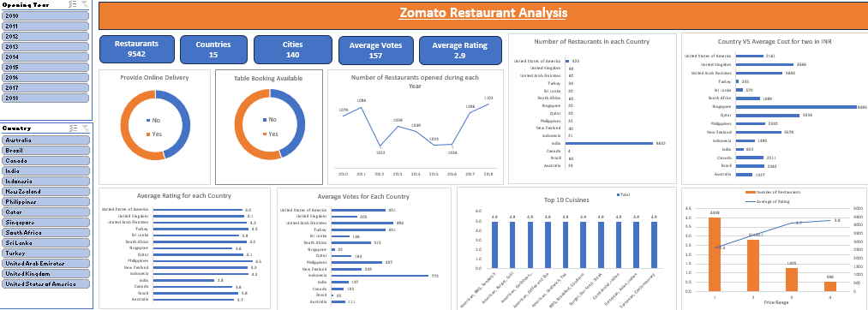
DASHBOARD
SLICER
Country
Opening Year
DONUGHT GRAPH
To have the idea of services availability in restaurants
Table booking
Online Order
BAR GRAPH
Average no. of voters per Country
Average rating of each Country
COLUMN GRAPH
Top 10 Cuisines with their average rating and Average Cost INR
Average Rating & No. of restaurants For different Price Range
LINE GRAPH to depict Restaurants opened Each Year

Slide 21
Recommendation
Strategies Recommended :
Focus on opening new restaurants in countries with untapped potential and favorable competitive conditions.
Prioritize cities and states within these countries that have lower restaurant density for optimal market entry.
Identifying the major competitors helps in understanding market leaders and their strategies.
Operations:
Implement online delivery and table booking systems to boost customer satisfaction and improve ratings.
Focus on offering high-quality cuisine and strategic pricing to effectively attract and retain customers

Slide 22
Conclusion :
Target under-served markets like Canada, where fewer restaurants and lower ratings indicate growth potential.
Open new locations in high-demand regions such as Australia and the UK to capture untapped customer interest.
Prioritize both online delivery and table booking in new locations, as these services significantly improve satisfaction and ratings.
Align pricing with a premium experience, as higher-priced establishments generally receive better feedback.
Continuously track performance and competitor data to refine our market approach and enhance customer satisfaction.

Slide 23


